Slide 1

Week 10/03/2023

Slide 2
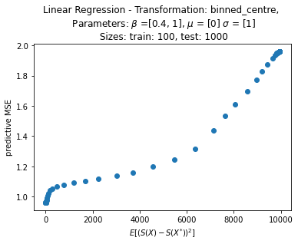
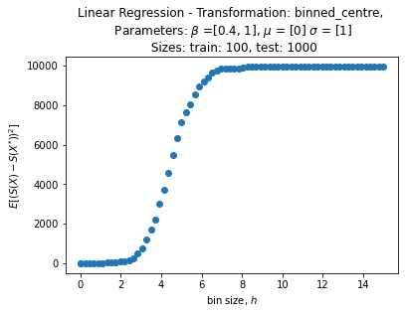
Univariate linear regression

Slide 3
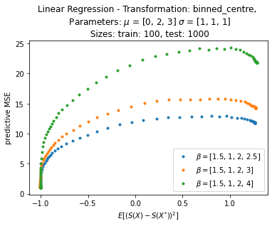
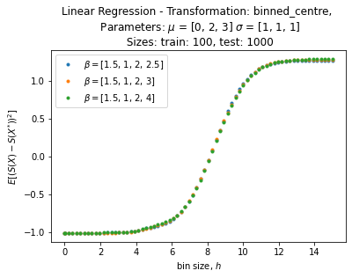
Extension to multivariate linear regression
3 DIMENSIONS – CHANGING BETA3

Slide 4
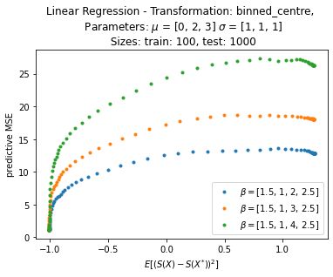
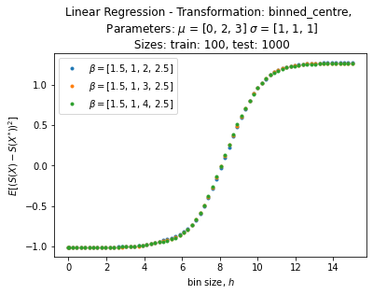
Extension to multivariate linear regression
3 DIMENSIONS – CHANGING BETA2

Slide 5
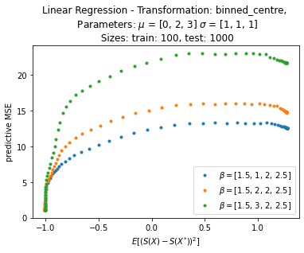

Extension to multivariate linear regression
3 DIMENSIONS – CHANGING BETA1

Slide 6
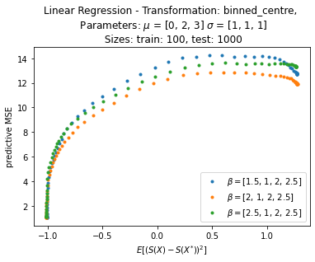
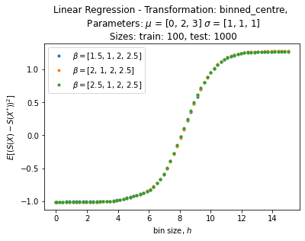
Extension to multivariate linear regression
3 DIMENSIONS – CHANGING BETA0

Slide 7
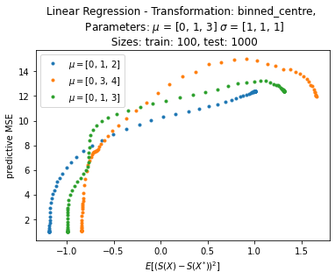
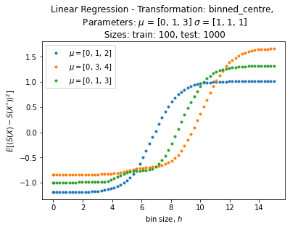
Extension to multivariate linear regression
3 DIMENSIONS – CHANGING MEANS

Slide 8
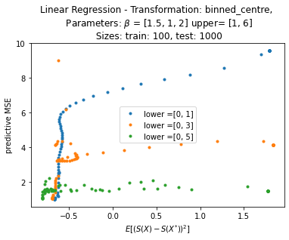
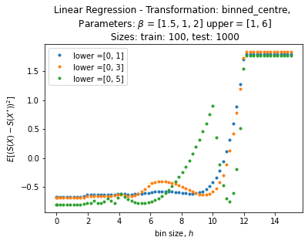
Extension to multivariate linear regression
3 DIMENSIONS – X sampled uniformly

Slide 9
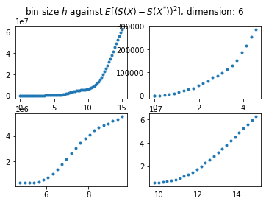
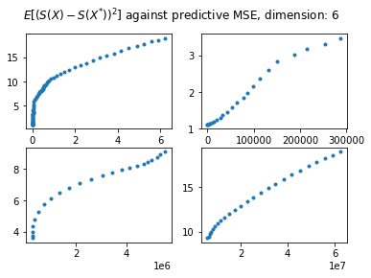

Extension to multivariate linear regression
6 DIMENSIONS

Slide 10
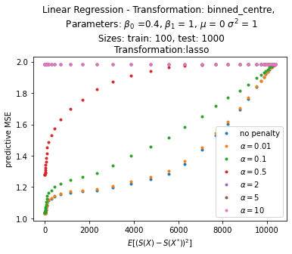
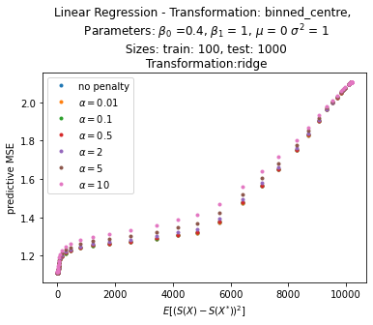
LINear regression
VARIOUS PENALTIES

Slide 11
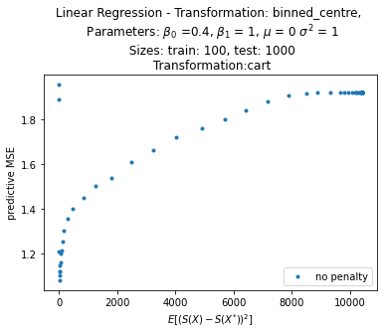
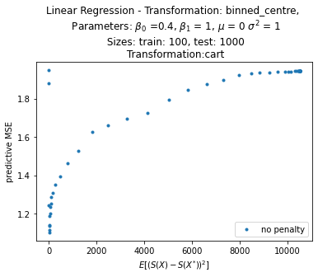
CART
Criterion = Squared_error
Criterion = Absolute_error

